Slide 1

CPSC 319 Data Structures, Algorithms, and Their Applications Winter 2024

Slide 2
Java
Java is designed as an object-oriented programming language.
Object-oriented programming involves organizing code into objects, which are instances of classes.
Objects in Java communicate through method calls, allowing them to collaborate and work together seamlessly.

Slide 3
Basic Terminologies in Java
Class: The class is a blueprint (plan) of the instance of a class (object). It can be defined as a logical template that share common properties and methods.
Example: Blueprint of the house is class.
Object: The object is an instance of a class. It is an entity that has behavior and state.
Example: Dog, Cat, Monkey etc. are the object of “Animal” class.
Method: The behavior of an object is the method.
Example: Barking of the dogs.
Fields: Every object has its own set of instance variables. The state of an object is generally created by the values that are assigned to these fields.
Example: Breed, color, and age of a dog.

Slide 4
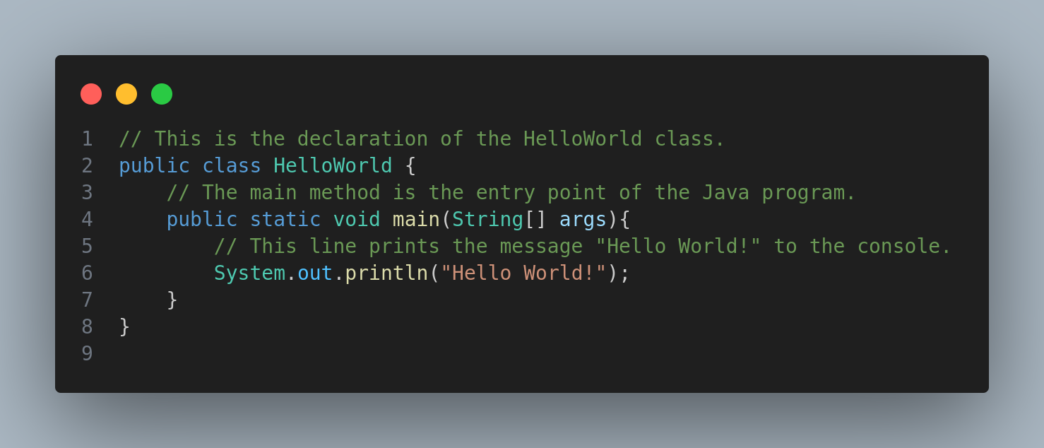
HelloWorld.java

Slide 5
Primitive Data Types
Basic building blocks of data in Java.
Directly manipulate values.
Fixed size.
Stored in memory for quick access.
boolean, byte, char, short, int, long, float, double
Ideal for simple, atomic values.

Slide 6
Primitive Data Types
Data Type | Size | Description
byte | 1 byte | Stores whole numbers from -128 to 127
short | 2 bytes | Stores whole numbers from -32,768 to 32,767
int | 4 bytes | Stores whole numbers from -2,147,483,648 to 2,147,483,647
long | 8 bytes | Stores whole numbers from -9,223,372,036,854,775,808 to 9,223,372,036,854,775,807
float | 4 bytes | Stores fractional numbers. Sufficient for storing 6 to 7 decimal digits
double | 8 bytes | Stores fractional numbers. Sufficient for storing 15 decimal digits
boolean | 1 bit | Stores true or false values
char | 2 bytes | Stores a single character/letter or ASCII values

Slide 7
Non-Primitive Data Types
Derived from primitive types and include more complex structures.
Can have methods and perform operations.
Dynamic size.
Stored by reference.
Arrays, Strings, Objects, Classes
Suited for more complex and structured data.

Slide 8
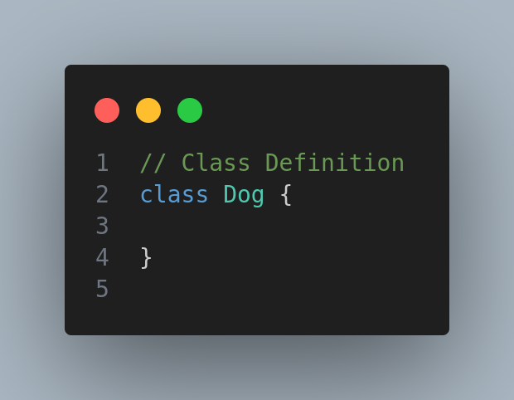
Defining a Class

Slide 9
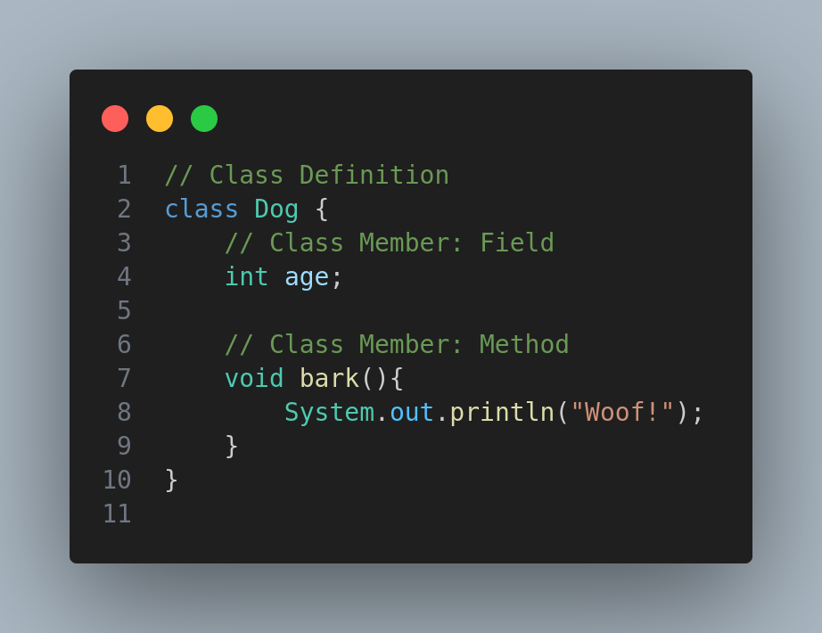
Defining a Class

Slide 10
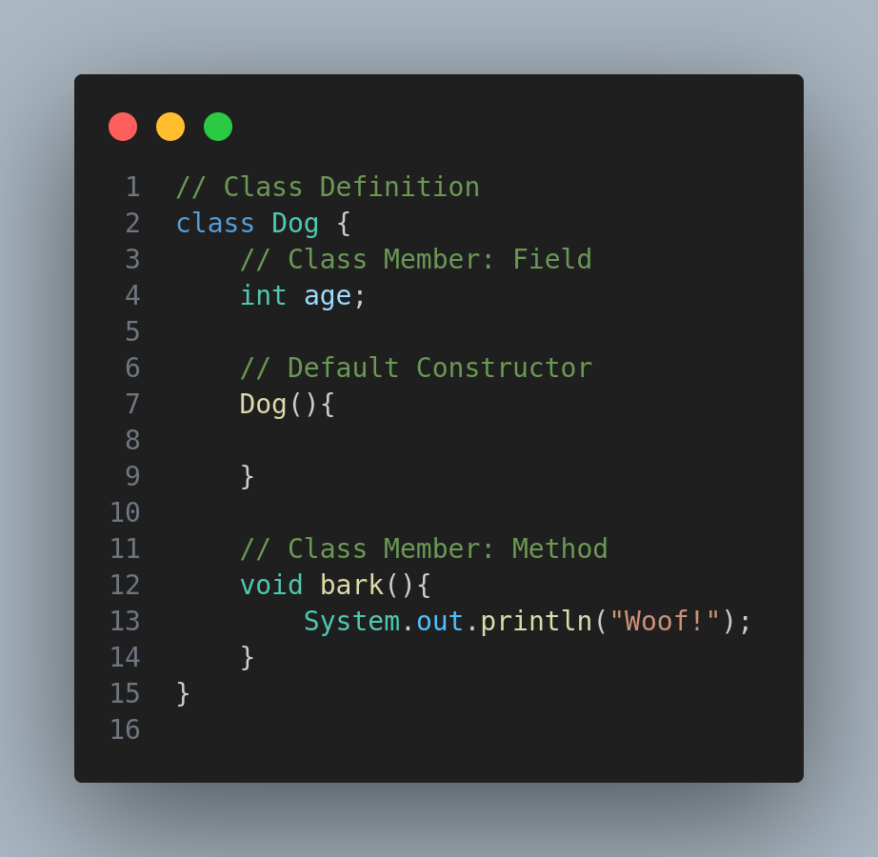
Defining a Class

Slide 11
Constructor
A constructor in Java is a special method within a class that is automatically invoked when an object of that class is created.
The primary purpose of a constructor is to initialize the state of an object, ensuring that it starts with a valid and known state.

Slide 12
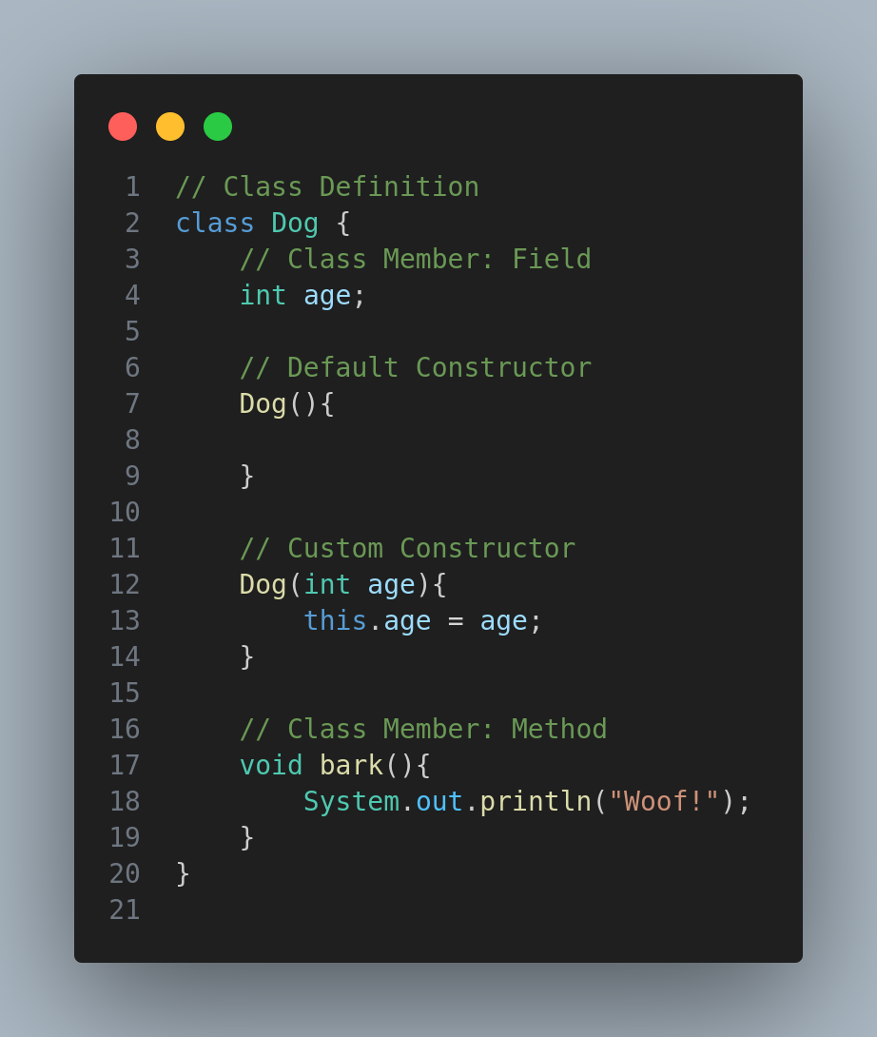
Defining a Class

Slide 13
Arrays
An array in Java is a data structure that allows you to store multiple values of the same data type under a single name.
Arrays are objects, and their elements are accessed using an index.

